Slide 1


Doctors
Web Application 2020-2021
Final Project
Nicola Levorato, Marcello Bullo, Manuel Bettin, Giovanni Piva, Pietro Balzan, Wiliam Scicchitano

Slide 2

Outline
Objectives
Data Logic
Application Logic
Presentation Logic
Demo time

Slide 3

Objectives

Slide 4
Main Functionalities
Our case study is about a group of doctors that work together with a pool of patients, a very common medical organization.
We want to implement a web application where both patients and doctors can interact easily
In particular:
doctor side: features dedicated to facilitate the cooperation with patients like remote prescriptions approval, examinations manager…
patient side: requests for prescriptions, exams, checkups and so on, without the need to go in person at the medical office.

Slide 5

Data Logic

Slide 6
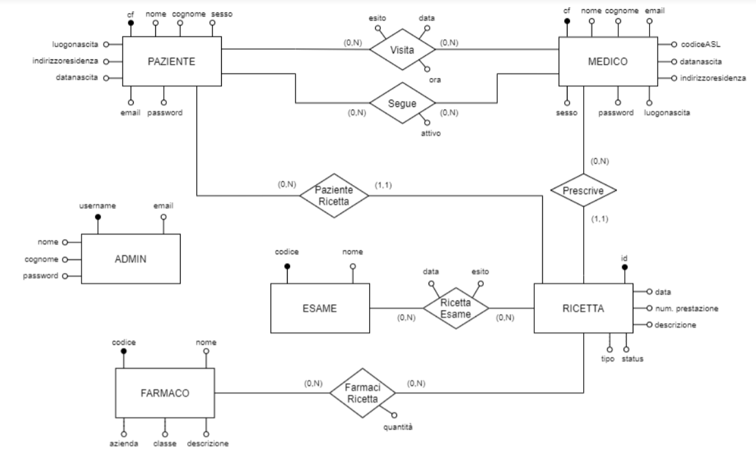

ER-Schema
Paziente
contains info about a patient

Slide 7
ER-Schema
Medico
contains info about a doctor

Slide 8
ER-Schema
Admin
manage specific function like deleting/inserting new doctors and new medicines in the db

Slide 9
ER-Schema
Ricetta
contains prescriptions information: each prescription is uniquely identified by an UUID type

Slide 10
ER-Schema
Esame
represents a medical examination identified with a unique code

Slide 11
ER-Schema
Farmaco
represents a medicines identified by uniquely defined code

Slide 12

Application Logic

Slide 13
REST
/rest/medicalExamination | POST
/rest/medicalExamination/{doctor_cf}/{date}/{time} | GET
/rest/medicalExamination/{doctor_cf}/{date}/{time} | PUT
/rest/medicalExamination/{doctor_cf}/{date}/{time} | DELETE
/rest/medicalExamination/patient/{patient_cf} | GET
/rest/medicine | GET
/rest/medicine | POST
/rest/medicine/{patient_cf} | GET
/rest/patient/list | GET
/rest/patient/{patient_cf} | GET
/rest/patient/{patient_cf} | DELETE
/rest/doctor/list | GET
/rest/doctor/{doctor_cf} | GET
/rest/doctor | POST
/rest/doctor/{doctor_cf} | PUT
/rest/doctor/{doctor_cf} | DELETE
Available REST resources:
Medical Examination
Medicine
Doctor
Patient
Exam

Slide 14
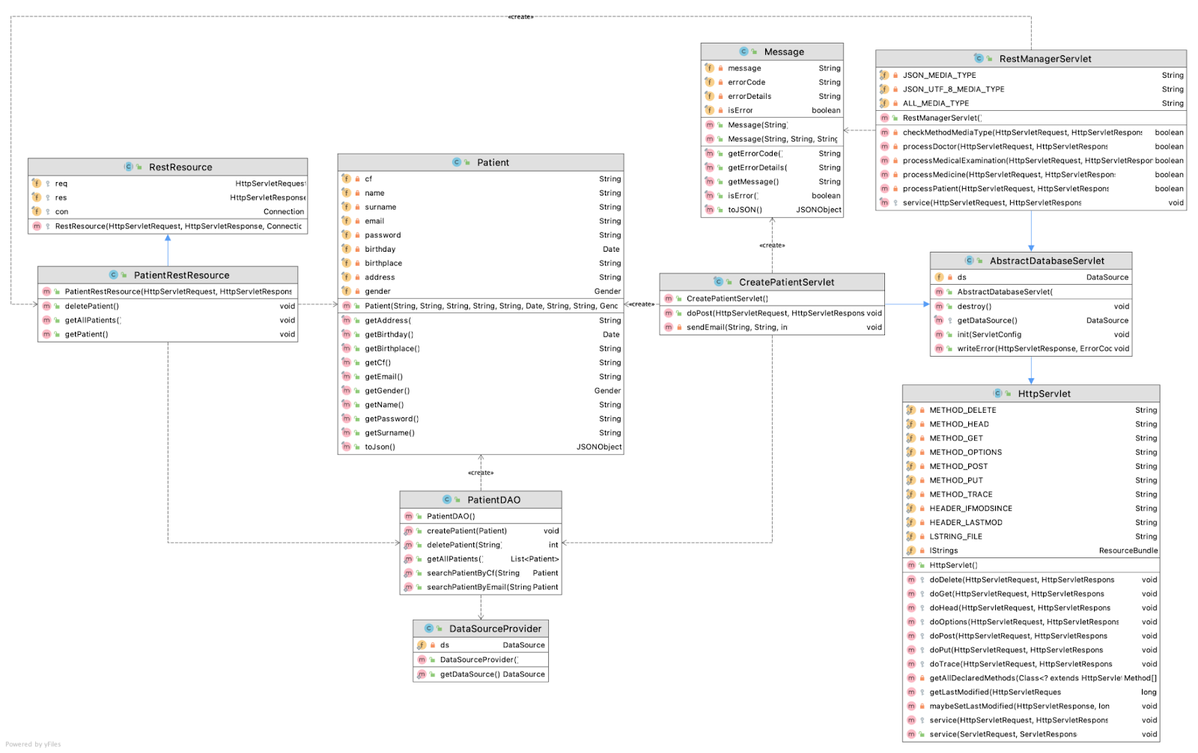
Class Diagram - Patient

Slide 15

Presentation Logic

Slide 16
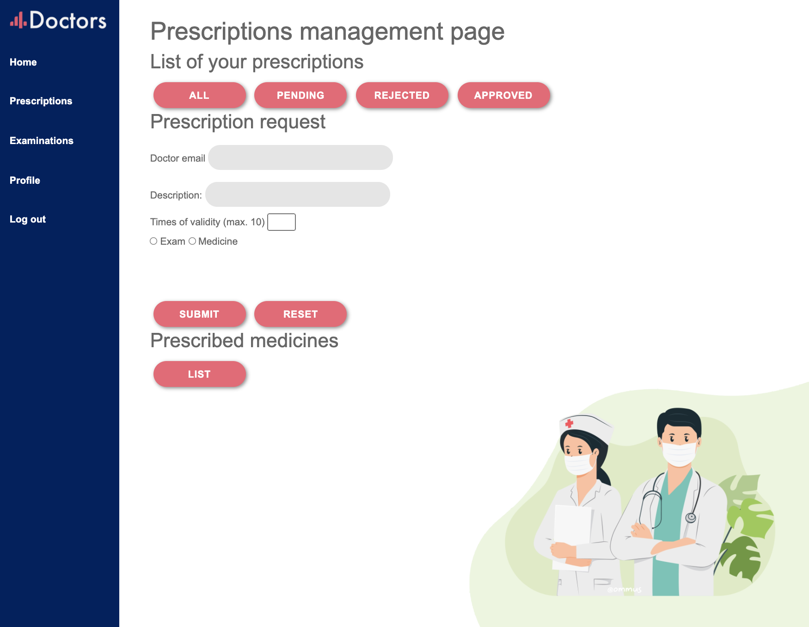
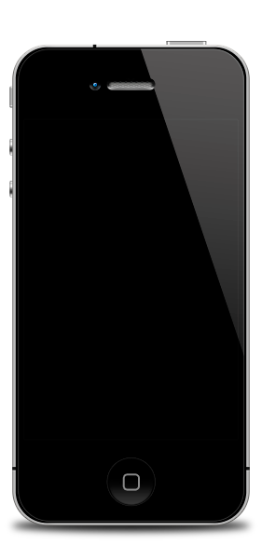
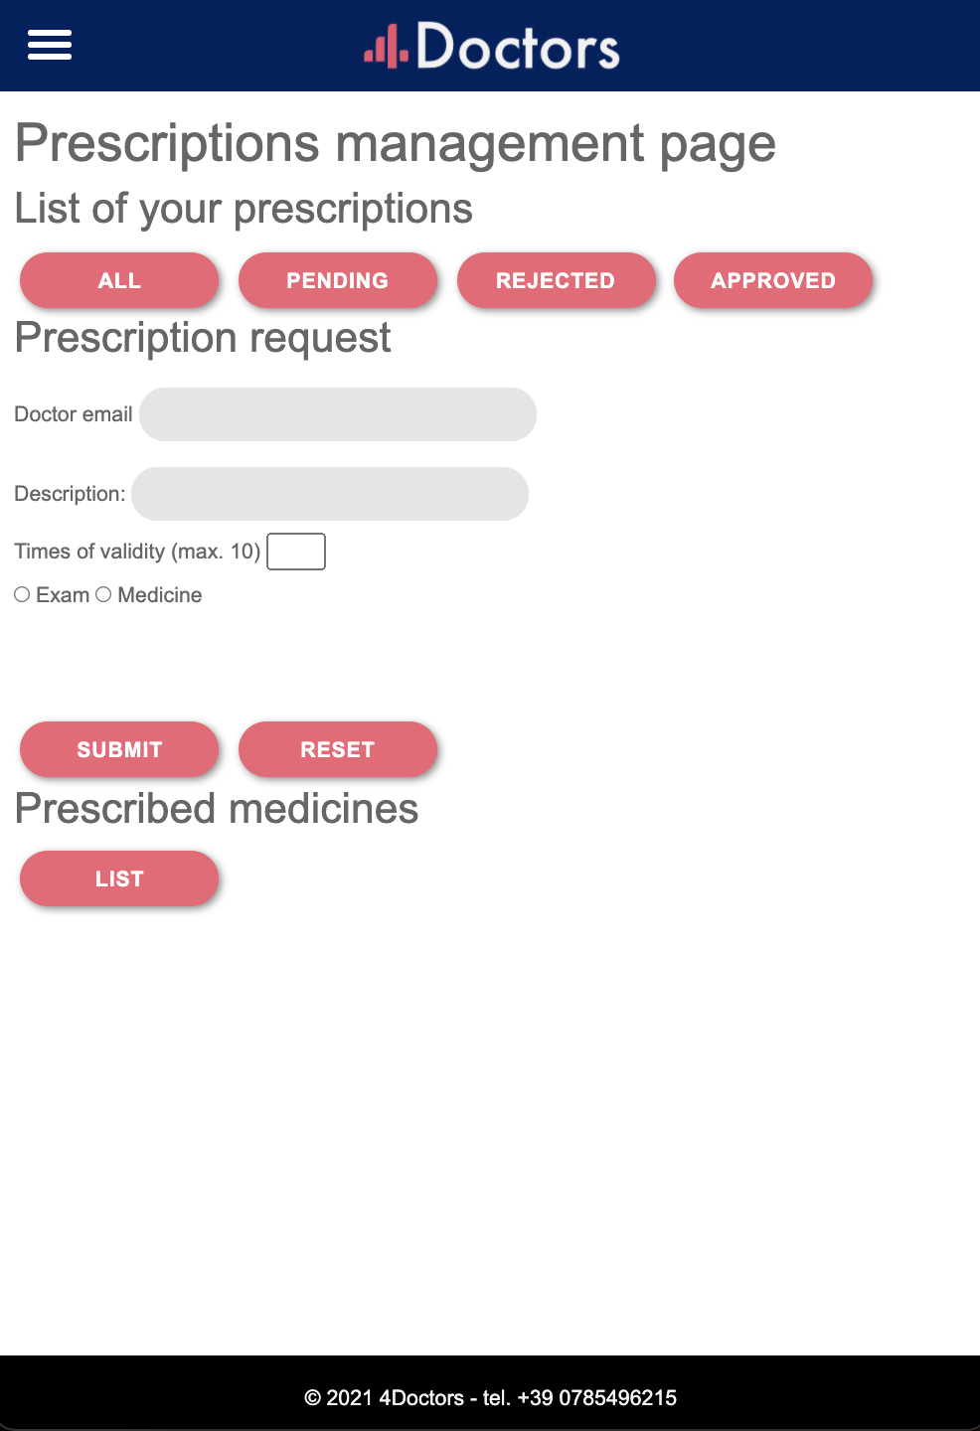
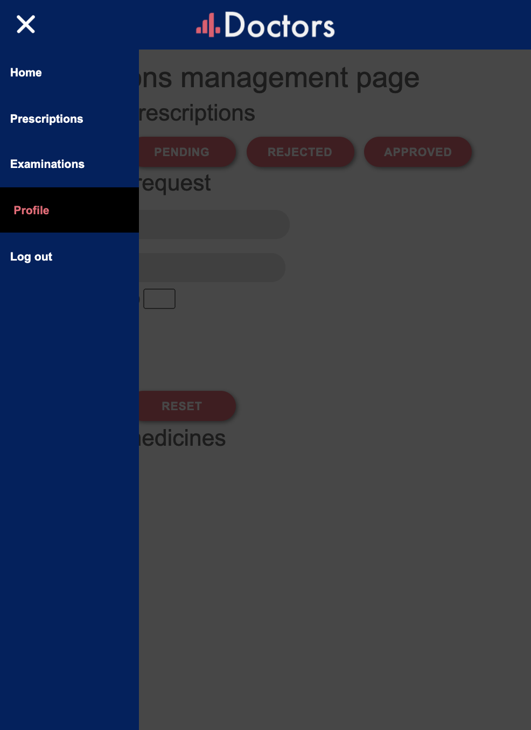
Presentation Logic

Slide 17
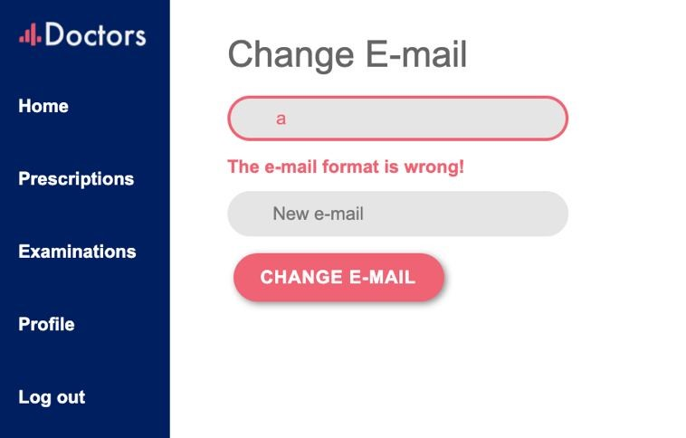
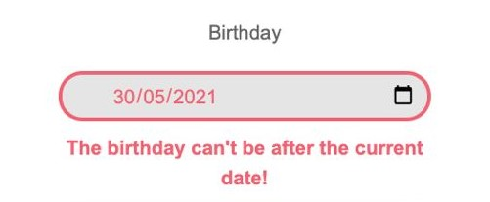
Form validation
Form validation is only performed when the submit event is triggered.

Slide 18
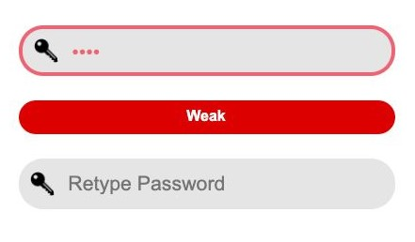
Password
Pwd Encryption
Frontend:
Performed through CryptoJS
Using SHA-3 algorithm
Pwd Validation
Backend:
MD5 encryption

Slide 19

Demo time

